Slide 1
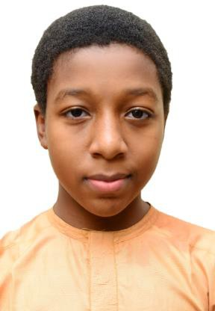
Portfolio
Ahmad Mohammad Umar
Email: ahmadmuhammadumarnaura2010@gmail.com
Phone: +2348035727437 (Mother)

Slide 2
Profile
I'm Ahmad, with a strong background in electronics and automation, specializing in developing efficient, precise, and real-time systems. My projects span multiple fields, including:
Fixed-Wing UAV for Surveillance – Designed a stable cylindrical UAV with a V-tail configuration using local material, and optimized for aerial surveillance and stability.
  Application Surveillance & Monitoring.
Greenhouse Automation System – Developed a microcontroller-based automated irrigation and nutrient dosing control system to enhance agricultural productivity and sustainability.
  Application Mitigating Climate Change Impact using Smart Urban Cluster Farming.
Efficient Fish Fingerling/Juveniles Counter – Created high-precision fish counting systems using infrared sensors and microcontrollers to ensure accuracy and prevent false counts in aquaculture.
  Application Fish Farming.
Robotic Prosthetics – Contributed to designing prosthetic systems that enhance mobility, precision, and user comfort.
  Application Health and Humanitarian Support.
Solar Thermal Thrusters – As part of the SpaceTIS Youth Team, Proposed innovation for future in-space missions. A game changer for missions such as the previous Disaster Monitoring Consortium (DMC), a satellite constellation that includes; NigeriaSat-1 and BilSat-1 Tubitak(Türkiye).
  Application Station keeping for prolonging spacecraft mission life, and In-Situ Resource Utilization (ISRU).
Code Debugging & Optimization, utilizing hybrid of high-level and low-level programming to improve execution speed and reduce memory usage.
  Application Coding Overhead reduction, and processor resource management.
Email: ahmadmuhammadumarnaura2010@gmail.com

Slide 3
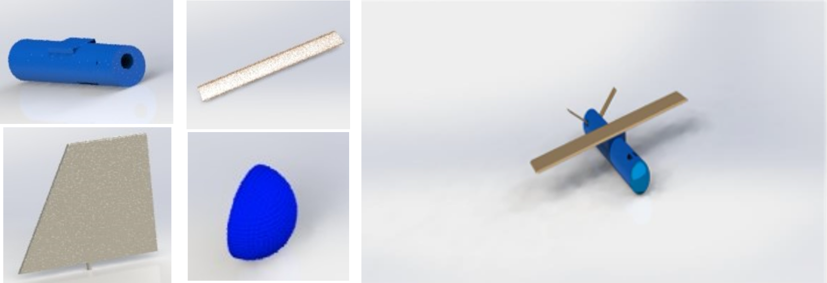
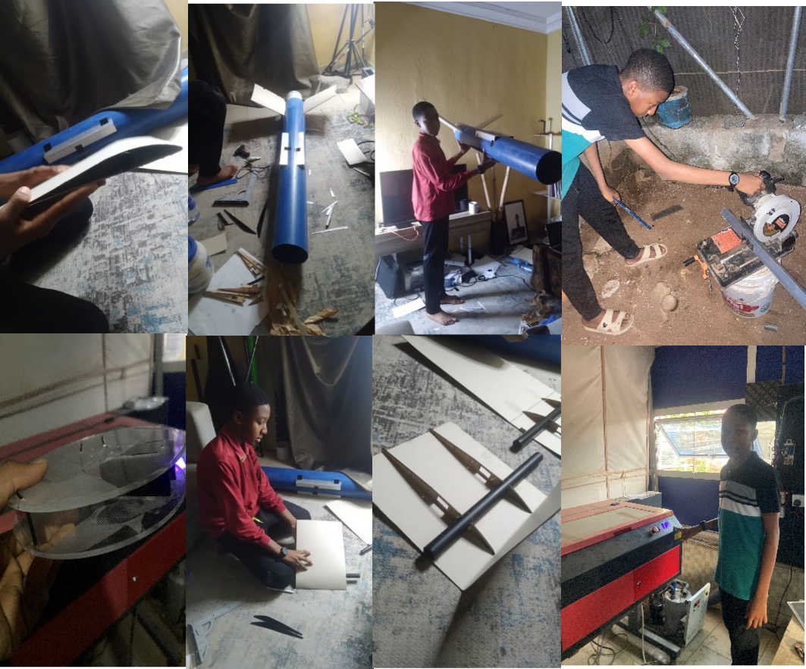
Fixed Wing UAV Design and Development Using Local Materials
Fuselage(PVC Pipe)
Wings(Corrugated Paper)
A cylindrical-body UAV with a V-tail, built for stability, endurance, and efficiency using affordable, locally sourced materials designed in SolidWorks.
Highlights:
Aerodynamic Design: Cylindrical shape for reduced drag made with Corrugated paper.
V-Tail: Improves maneuverability and lowers weight.
Local Materials: Durable, lightweight, and cost-effective materials like Corrugated Paper, PVC Pipe, Iron Bars and Rods, Acrylic and Toilet Floaters.
Autonomous Ready: Autopilot integration planned.
Surveillance Systems: Real-time sensor and communication capabilities.
Current Progress: Structural design and prototyping complete.
Next Steps: Autopilot, comms, and sensor integration.
VTail(Corrugated Paper)
Nose(Toilet Floaters)
Assembled
Email: ahmadmuhammadumarnaura2010@gmail.com

Slide 4
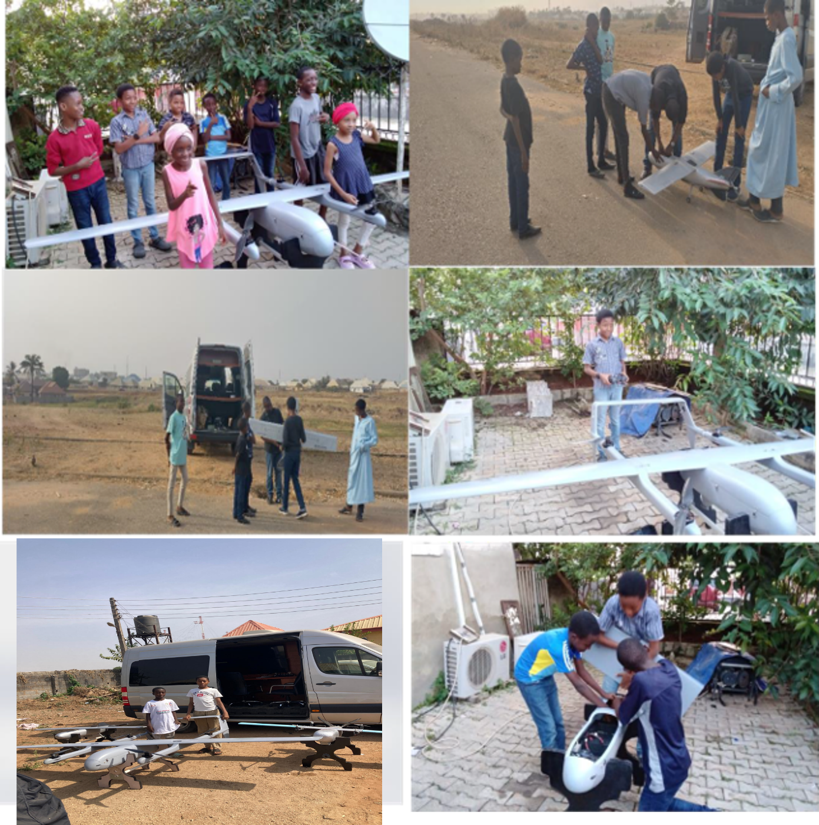
VTOL-Fixed Wing UAV Assembly and Flight Test
VTOL-Fixed Wing UAV Assembly & Flight Test:
Combined vertical takeoff and long-range flight capabilities.
Initial testing revealed high costs associated with importing parts and materials.
Inspired the design of a more affordable UAV using locally sourced materials.
Focused on maintaining performance, sustainability, and reducing overall cost.
Email: ahmadmuhammadumarnaura2010@gmail.com

Slide 5
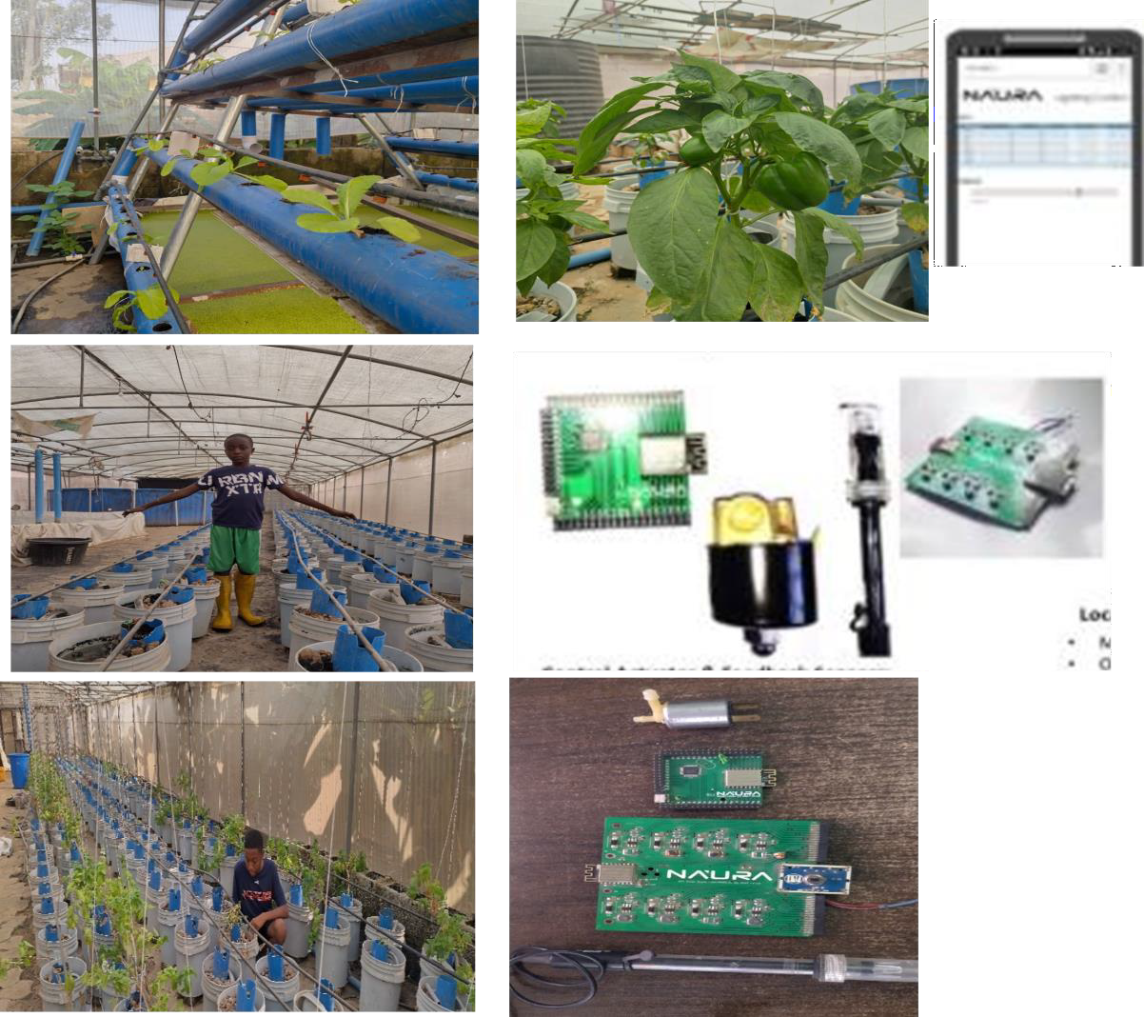
Green House Automation System (Completed)
Microcontroller-Based Agricultural Automation system designed to enhance productivity using locally sourced materials for
cost-effective automation of irrigation and climate
control.
Key Features:
Automated Irrigation – Uses sensors to activate watering based on soil moisture.
Climate Control – Fans and misting systems
regulate temperature & humidity.
Locally Sourced Materials – Ensures affordability, easy maintenance, and sustainability.
Remote Monitoring – Supports mobile app integration for real-time control.
Impact & Efficiency:
Optimizes water use while improving plant growth.
Reduces labor costs with automation while
promoting local material use.
Email: ahmadmuhammadumarnaura2010@gmail.com

Slide 6
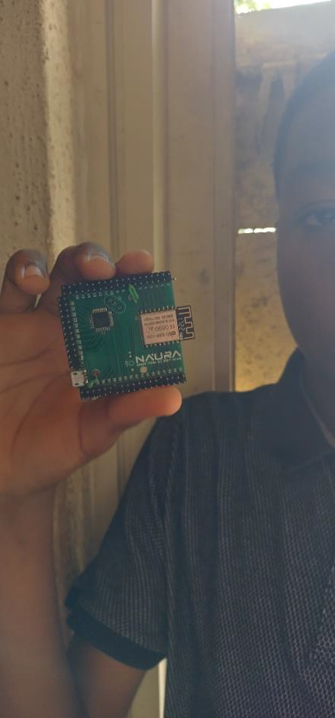
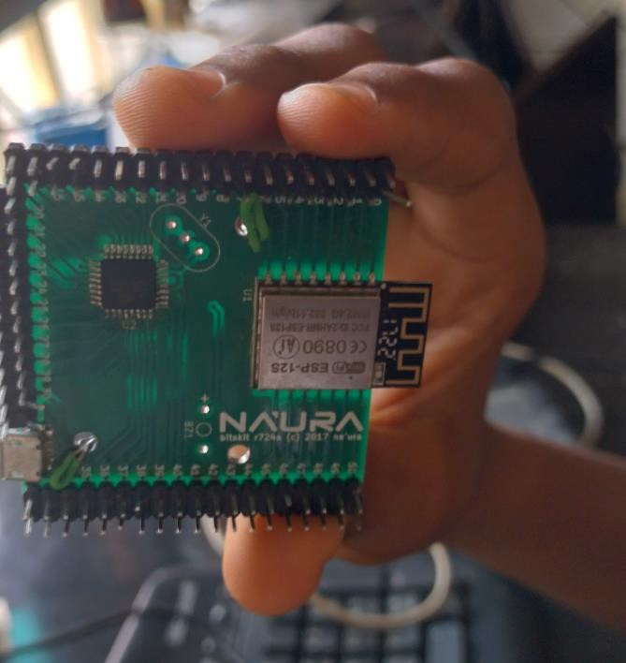
IoT-Based Fish Fingerling/Juvenile Counter Electronic Board
A reliable fish counting solution using locally made materials
to enhance accuracy and efficiency in aquaculture.
Key Features:
Infrared Sensor-Based Counting – Prevents double counts for precise results.
Adjustable Counting Speed – Eliminates errors from water movement or rapid fish passage.
Buzzer Alert System – Notifies when a preset count is reached.
USB Power Supply – Compatible with power banks for
portability.
Efficiency & Accuracy:
Reduces manual labor and counting errors.
Prevents overstocking or understocking of fish ponds.
NAURA means technological devices in Hausa
Email: ahmadmuhammadumarnaura2010@gmail.com

Slide 7
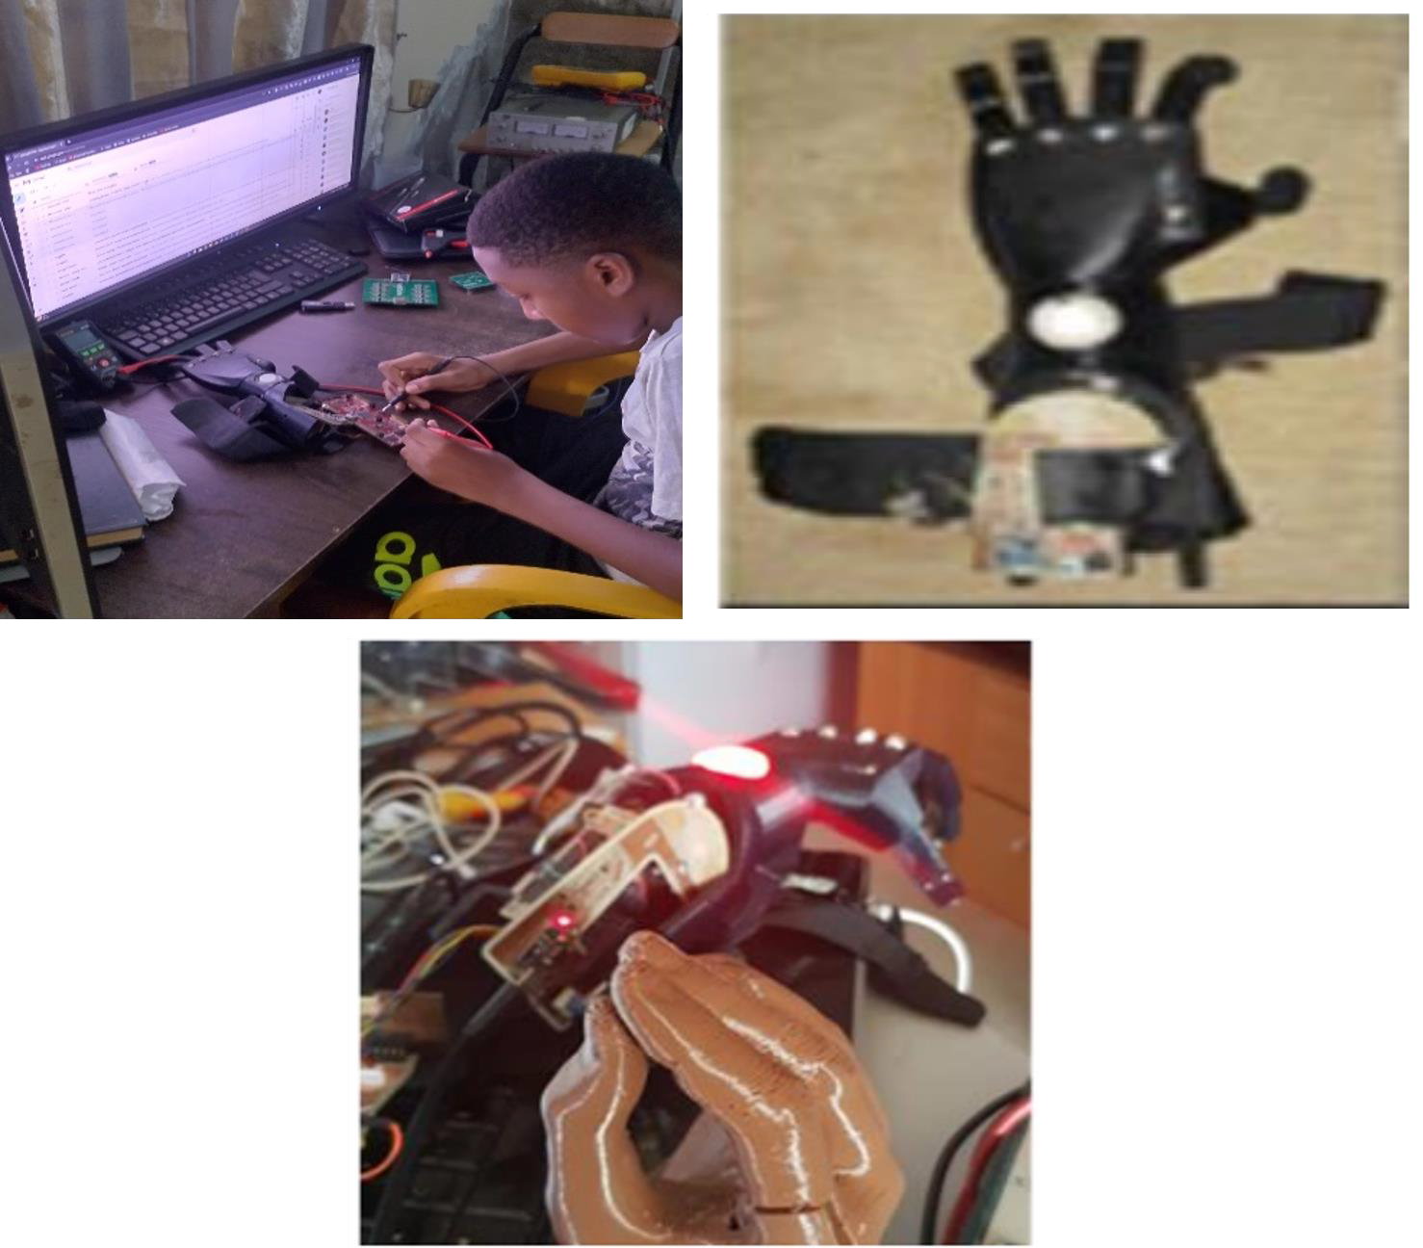
Robotic Prosthetics (In Development)
A high-precision prosthetic using locally made materials to enhance mobility, adaptability, and user comfort.
Key Features:
Sensor-Controlled Movement – Detects muscle signals for
natural motion.
Locally Made Lightweight & Durable Materials – Ensures comfort, affordability, and extended use.
Customizable Fit – Adaptable to different users' needs.
Current Progress: Prototyping phase – Testing sensor accuracy and mechanical structure.
Next Steps: Enhancing user adaptability and refining control
algorithms.
Email: ahmadmuhammadumarnaura2010@gmail.com

Slide 8
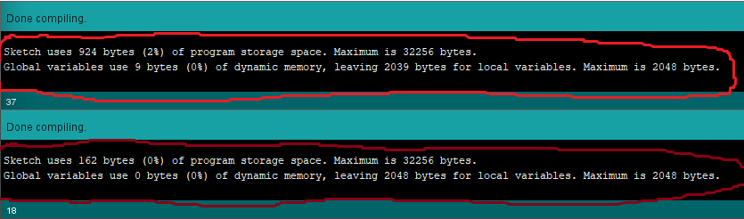
Code Optimization (Ongoing Applications)
Enhancing performance, memory efficiency, and power consumption by replacing Arduino libraries with direct AVR-GCC
programming (implemented in Arduino led blink code and watchdog timer)
.
Key Improvements:
Reduced Memory Usage – Flash memory reduced by 80%, allowing room for more complex embedded tasks.
Faster Execution – Fewer processing cycles for real-time performance.
Lower Power Consumption – Optimized code minimizes CPU activity, extending battery life.
Application Areas:
Low-power embedded systems.
High-performance real-time applications.
Arduino-Code: program space
924 bytes
Test Code: LED Blink
AVR-GCC Code:
program space
162 bytes
Email: ahmadmuhammadumarnaura2010@gmail.com

Slide 9
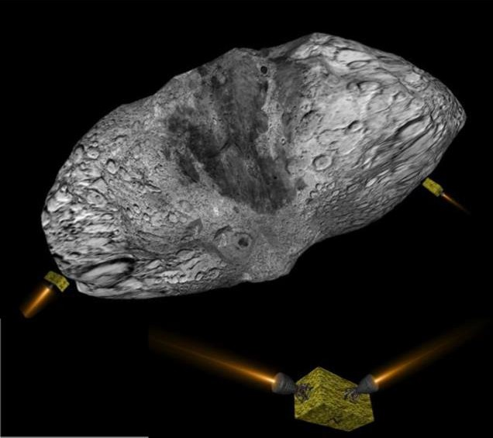
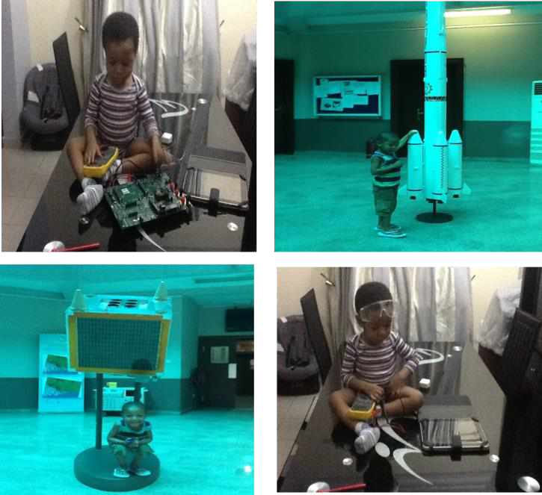
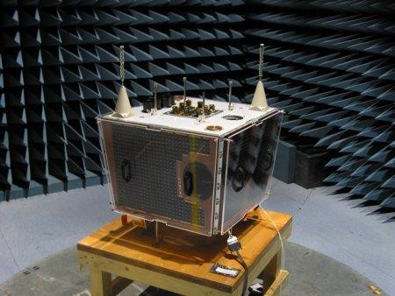
Solar Thermal Thruster
Unlocking the future of sustainable space exploration using fluid-agnostic
propellants(water, ammonia, methane etc.)
Key Improvements:
Mission scenario development
Propellant trade-off (in specific impulse, thrust and availability)
Application Areas:
Efficient satellite station-keeping,
Asteroid mining and deep space exploration
BilSat-1(Türkiye)
NigeriaSat-1(Nigeria)
Email: ahmadmuhammadumarnaura2010@gmail.com

